Slide 1
CCRIF: A Natural Catastrophe Risk Insurance Mechanism for Caribbean Countries
Disaster Risk Reduction and the Private Sector
16 March 2010
Nayarit, Mexico
Prepared by:
Caribbean Risk Managers Ltd, Facility Supervisor

Slide 2
Presentation Format
PART I
CCRIF overview and background
CCRIF role in disaster risk management
Performance to date
PART II
Regional role of CCRIF – Application of Risk Analysis and Modeling for Disaster Risk Reduction
Agricultural Sector
Summary points

Slide 3
The Caribbean context
Caribbean countries are highly vulnerable to natural disasters, which have caused them average losses amounting to 2% of GDP since 1970
Only 3% of potential loss is currently insured in developing countries vs 45% in developed countries
Immediate access to liquidity is critical for governments and individuals post disaster
Smaller nations with high debt burdens can no longer afford to self-finance disaster risk
Vulnerability
Low Coverage
Liquidity
Debt Burden

Slide 4
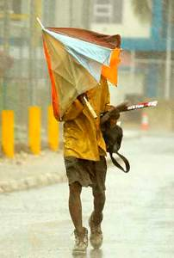
History
Pooled re/insurance solution for Caribbean governments first called for by CARICOM Working Party on Insurance after Hurricane Andrew (’92)
Andrew resulted in US$250 million in damage in Bahamas alone
Revived in 2004, after Hurricane Ivan inflicted almost 200% of GDP damage on Grenada and the Cayman Islands
All parties identified the high exposure of small island economies across the region to natural hazards, and the consequential risk to sustainable development
CARICOM Heads of Government asked the World Bank to assist in designing and implementing a cost-effective risk transfer programme for member governments

Slide 5
Aims of CCRIF
Stakeholders identified the need for a mechanism to provide:
Funds to cover the post-disaster liquidity gap faced by governments between immediate emergency aid and long-term redevelopment assistance
A facility which would enable governments to receive money quickly, with the payout calculated in a completely objective way
A mechanism which would minimise the burden on governments to provide exposure information prior to coverage being initiated and loss information after a disaster

Slide 6
What is CCRIF?
Began operation in 2007 CCRIF is the world’s first multi-national risk pool to cover sovereign risk via parametric insurance
A regional catastrophe fund for Caribbean governments designed to limit the financial impact of devastating hurricanes and earthquakes by providing liquidity very quickly after a major event
Controlled by the 16 participating governments, with each government paying a premium related to its own risk exposure and being able to buy coverage up to an annual aggregate limit of US$100 million per peril
Functions like business interruption insurance against Government revenue reductions in the aftermath of major natural catastrophes• Coverage is designed to cover short term revenue shortfall an NOT infrastructure, indirect social costs etc
Capitalised by donors and participants (via a membership fee). CCRIF initially raised capital to cover claims and operating costs from donors (c. US$50 M) and from its participants (c. US$22 M). Donor capital now over US$65 M
Claims paying capacity is greater than the modelled aggregate annual loss with a 1 in 10,000 chance of occurring
Uses parametric index which converts wind speed (for storm) or ground acceleration (for quake) into a government loss estimate at key sampling sites, which are aggregated to national loss

Slide 7
Sovereign liquidity gap

Slide 8
The Financial Protection of the State
Source of Financing Post-disaster
Instrument s | Availability of funds
Reserves | Immediate
Budget Reallocations | -
Contingent Lines of credit | Immediate
Emergency Loans | 3-6 months
Donor contributions | 3-6 months
Traditional Insurance | 3-6 months
Parametric Insurance | Immediate
Catastrophe Bonds | Immediate
Notes:
I included this slide here to give a sense of the suite of instruments countries often tap into after a catastrophe occurs and timelines in which these instruments become available and so therefore the question begs of how do we combine these instruments to protect the fiscal balance of the state and improve its capacity to respond in case of a natural disaster.
These instruments can of course range from reserves, to budgetary reallocations to catastrophe bonds and emergency loans and donor contributions with correspondingly different times lines in which such instruments can become available i.e. reserves and lines of credit, parametric insurance which often become available immediately could be effectively used in the emergency response and recovery phase while donor assistance and traditional insurance instruments and emergency loans can be leveraged for the long term infrastructural investments to aid the development of the state

Slide 9
CCRIF performance to date
Paid out approximately US$33 million since its inception (3.5 years)
2007 – US$1 M to St. Lucia and Dominica 29 November earthquake in Eastern Caribbean | 2010 - US$4.2 M to Anguilla Hurricane Earl (September)
2008 – US$6.3 M to the Turks & Caicos Islands Hurricane Ike | 2010 - ~US$8.5M to Barbados Hurricane Tomas (October)
2010 – US$7.75 M to Haiti 12 January earthquake The first set of funds to be received by the Government of Haiti inclusive of all pledges, regional and international Represented perhaps 50% of the TOTAL aid Government of Haiti received in first 10 weeks in the form of direct liquidity | 2010 - ~US$3.2M to ST. Lucia Hurricane Tomas (October)
 | 2010 - ~US$1.1M to St. Vincent and the Grenadines Hurricane Tomas (October)
Strong proof of concept

Slide 10
Insurance as a Risk Reduction Tool
Insurance is a natural companion to risk reduction within an overall risk management framework (parametric especially, because ‘moral hazard’ is removed)
Risk reduction is vital and should be continuous
Risk transfer (insurance) is cost efficient to handle risks that are too expensive to reduce/mitigate
Catastrophe risk transfer is an efficient way to address ‘residual’ climate change risk (risk that cannot be adapted to in a cost efficient way), much of which is due to low-frequency, high impact events
Notes:
So what are the lessons to be learnt from this experience:
The fact that Parametric and of course traditional insurance are both natural companions to risk reduction within an overall risk management framework.
It is important to however note that Risk reduction is vital and should be continuous and is indeed priority.
Risk transfer (insurance) is indeed a cost efficient means to handle risks that are too expensive to reduce/mitigate but I will reiterate that it is by no means a SILVER BULLET. Risk transfer and by extension insurance is just one tool within a suite of measures countries can employ to enhance their resilience and these measure themselves are only useful is they are embedded within a wider comprehensive disaster management framework in which risk reduction is paramount.
The work of CDEMA in this regard within its member states is therefore extremely laudable

Slide 11
PART II Regional Role of CCRIF
Potential for catalysing new risk
management tools for Disaster Risk Reduction

Slide 12
Regional role of CCRIF
Apart from assisting in the recovery and reconstruction process through provision of liquidity, CCRIF is also engaged in the following:
Facilitating the implementation of risk management measures that reduce risk and heighten resilience
Promoting risk assessment and risk management tools at all levels (e.g. Real Time Forecasting System)
Involved in the design of suitable index-based or hybrid (insurance) products at sub-national level either directly or via community-based partners

Slide 13
CCRIF Modelling Platform
Development of the Second Generation (2G) model by Kinetic Analysis Corporation in conjunction with CaribRM
Further refinement for CCRIF, and
broadens the scope of potential financial instruments which could be made available for risk management and mitigation in both the public and private sectors
This new platform enables the use of either a hazard index or modelled-loss as the basis for parametric contracts
Its modular and highly scalable architecture enables new hazard modules and a variety of exposure database formats (including gridded and point-data exposure) to be simply added

Slide 14
Rainfall Model
In addition to the multi-hazard 2G model, CCRIF and KAC, in partnership with the Caribbean Institute for Meteorology and Hydrology (CIMH), has completed a rainfall model focused primarily on quantifying rainfall at high resolution for extreme events
The rainfall model is of particular interest in the agriculture sector
CCRIF will be using the base rainfall accumulation as a basis for its new excess rainfall policy
Rainfall will be aggregated at the basin level in either flat or flow accumulations (depending on a verification exercise) and weighted according to relative exposure within a basin to produce an extreme rainfall impact index
This new product will be aimed at helping to mitigate the economic consequences of major rainfall events on governments – it will NOT focus particularly on agriculture although agricultural exposure will be taken into account in the indexing methodology

Slide 15
CCRIF Role in Agricultural Risk Management
Can assist in risk modelling through making available the new 2G modelling platform which can be focused specifically for agricultural risk
Can provide parametric reinsurance against the portfolio of indexed risk held by the government, growers association or other risk aggregators at the national or sub-national level
Can advise in product design, capacity building and education concerning parametric insurance mechanisms
CANNOT sell and administer policies to multiple individuals – CCRIF not designed for that purpose

Slide 16
Schematic of CCRIF role

Slide 17
Why is this important for the agriculture sector?
Agriculture important to the region:
Major revenue earner
Major employer, especially rural populations
Critical for national and regional food security
But the sector suffers from:
High vulnerability to increasingly volatile and extreme weather patterns
Absence of a sufficiently coordinated framework for agricultural disaster risk management at the national and regional level
Risk mitigation measures severely inadequate and the traditional risk management strategies which have included the use of savings, accessing loans, crop diversification, use of drought resistance-low yielding cultivars and species, and provision of relief by Governments in the face of disasters have proven to be neither robust nor efficient in preventing serious economic loss and allowing speedy recovery
This largely contributes to limited investment in agricultural production and marketing.
An absence of agricultural insurance is identified as one of the major binding constraints limiting investment to develop competitive and sustainable agriculture in the region

Slide 18
Importance
Disaster risk management including agricultural insurance has re-emerged as a topic of interest to governments and other policy makers and stakeholders – private and public sector
Factors responsible for this renewed interest include:
Susceptibility of the sector to climate change
fluctuations in international commodity prices has increased the need to urgently enhance the agricultural competitiveness in the region to facilitate economic and financial stability
urgency to enhance food security both nationally and regionally
Strengthened support for agriculture to reduce poverty and improve incomes of rural communities in the Caribbean

Slide 19
Linking to Insurance for the Agricultural Sector
CCRIF looking to provide technical expertise in product design, capacity building and education concerning parametric insurance mechanisms and how this can be used to fill some gaps in the sector
Also actively involved in seeking ways to address and catalyse solutions to middle-level weather-related risks (return periods of 10-20 years)
CCRIF and partners can facilitate public safety nets and public-private insurance solutions for vulnerable people
Also involved in finding ways to link these insurance solutions to DRR for catalytic adaptation benefits
Working with national, regional and international partners to achieve this – e.g.
Bahamas Government – FAO
German Ministry of Environment - Munich Climate Insurance Initiative (MCII) – United Nations University -Microensure

Slide 20
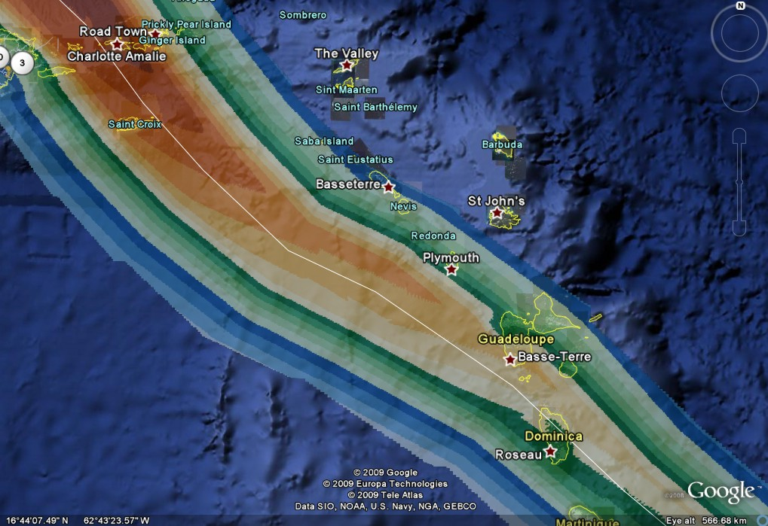
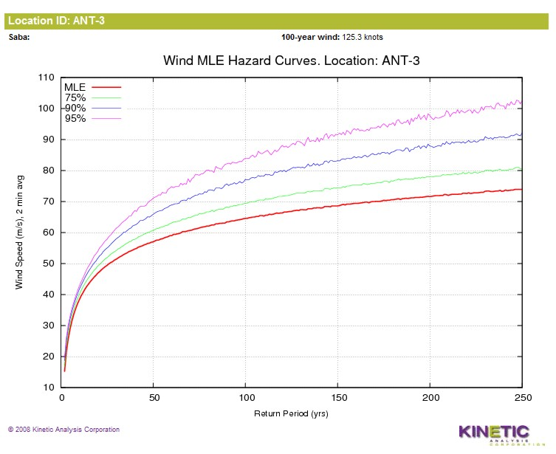
Real Time Forecasting System (RTFS)
Promote risk assessment and risk management tools at all levels (e.g. Real Time Forecasting System.)
CCRIF provides real-time storm impact forecasts (RTFS) for all member countries. Forecasts cover:
Maximum wind speed, storm surge height, wave height, and cumulative rain in the swath of the storm
Expected damage levels, power outage, and disruption to port and airport operation
Forecasts are updated with every new NHC advisory, and are available shortly after advisory.
Available in Google Earth, and as ESRI shapefiles
Notes:
CCRIF provides real-time storm impact forecasts (RTFS) for all member countries. Forecasts cover:
Maximum wind speed, storm surge height, wave height, and cumulative rain in the swath of the storm
Expected damage levels, power outage, and disruption to port and airport operation
Forecasts are updated with every new NHC advisory, and are available shortly after advisory.
Available in Google Earth, and as ESRI shapefiles

Slide 21
Application of TAOS-RTFS
SHELTER MANAGEMENT
Identify impact areas and shelter locations to support shelter allocation decisions
Identify potential damage to shelters and plan for alternatives
EMERGENCY INTERVENTION
Identify areas where population is at risk and issue warnings, plan for assistance
Update country plans as needed with new information from latest forecast
Obtain a preview of what might happen if a given storm continues along its projected path, and activate appropriate contingency plans based on this insight
CONTINGENCY PLANNING
Notes:
Through the provision of advanced knowledge of a hurricane’s expected site specific impacts greater support is provided to disaster coordinators, meteorological officers and others in their decision making processes i.e. the tool could assist in
Contingency Planning through
provision of a preview of what might happen if a given storm continues along its projected path, and activate appropriate contingency plans based on this insight
Update country plans as needed with new information from latest forecast
Shelter Management
Identify impact areas and shelter locations to support shelter allocation decisions
Identify potential damage to shelters and plan for alternatives
Emergency Intervention
Identify areas where population is at risk and issue warnings, plan for assistance

Slide 22
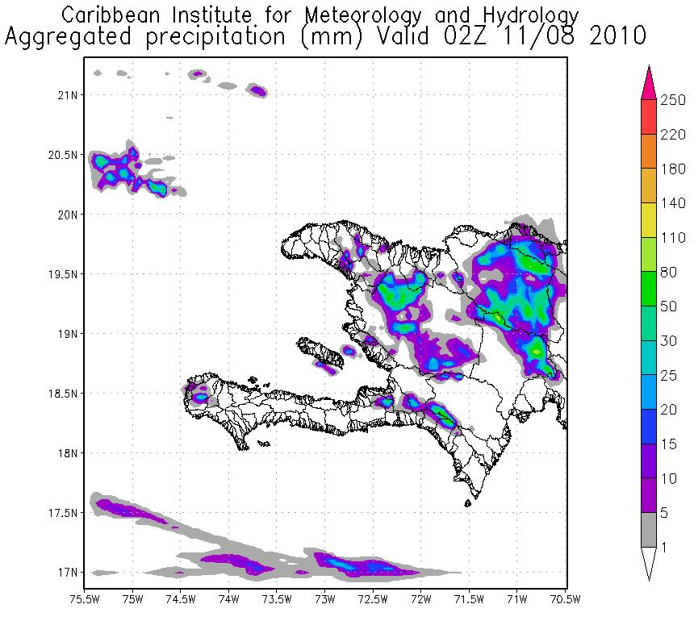
Weather Research and Forecasting Model (WRF)
Less than 24hrs after the January 12 earthquake CIMH began producing high resolution (4km) predicted rainfall over Haiti daily
WRF rainfall forecast outputs for Haiti:
produced on a operational basis
posted as quickly as possible
covering a 48-hour forecast period
Provide early warning of potential heavy rain events and their location, which are superimposed on the overall drainage basin configuration (as well as draped over topography)
Help end-users visualise the areas that could be impacted
Notes:
WRF – Weather research and Forecasting Model

Slide 23
Organisational and Governmental Use
Information/tools made available to:
Haitian Government
Civil Protection Directorate
Centre National de Meteorologie
World Bank
International Research Institute for Climate and Society (IRI) at the Columbia University Earth Institute
UN-OCHA (primarily interested in the information for short-term contingency planning)
IFRC (International Federation of Red Cross and Red Crescent Societies) – lead the Haiti Shelter Cluster
WFP (World Food Programme) – lead the Haiti Logistics Cluster
CIMH provides technical assistance and training support in the use of the tools where and when required (training provided to several OCHA, IFRC and WFP representatives)

Slide 24
Climate risk management in adaptation framework at UN-FCCC
‘Insurance’ within the climate change adaptation context has a long history (going back to 1992)
Concept not really turned into actionable ideas until lead-up to Copenhagen
CCRIF cited as example of potential role of regional risk pool in marrying public and private sectors
CCRIF has opened a door to pro-active management of sovereign cat risk in the developing world
It has been recognised as an important tool to manage short-term liquidity risk, and is being increasingly cited as both a model for other regions and as a catalyst for new risk pools in the Caribbean
The example of CCRIF has enabled some meat to be put on the bones of the ‘insurance’ elements of the UN-FCCC adaptation negotiations

Slide 25
Climate Change Problem
CCRIF has recently supported the first phase of a study of the economics of climate adaptation (ECA) for the Caribbean
First meaningful quantification of the impacts of CC on risk, and ways to cost-effectively adapt (risk reduction + risk transfer) – at national and sectoral level
Climate change clearly brings variability to hydro-meteorological hazards (generally upward, particularly for catastrophe hazards)

Slide 26
Economics of Climate Adaptation (ECA) project
Notes:
Another main initiative pursued over the past couple of months under the TECHNICAL ASSISTANCE umbrella is undertaking a study on the “Economics of Climate Adaptation” within the region.
The Study was launched in February to enhance the development of a fact base for developing sound climate adaptation strategies within the region.
The initiative is being executed by CCRIF Facility Supervisors, CaribRM in conjunction with the Caribbean Community Climate change centre, with input from UNECLA. Analytical support to the project is provided by SwissRE and McKinsey & Company, which is a consultancy firm.

Slide 27
Methodology overview
Notes:
The innovation of the ECA methodology lies in its positioning across different sectors spanning climate science, the financial industry and economic research.
The analysis if based on joining 4 main elements:
Climate change scenarios based on the most recent available scientific evidence
Hazard models forecasting the occurrence of hurricanes or other damaging events
Economic damage functions linking the intensity of events to economic impact
Value distribution models describing each country’s economic and population exposure to hazards in a granular and precise way.
To achieve this the team has been involved in intensive data collection and analysis over the past few months and in practical terms to gather the type of data described in the diagram above
The output of this was a regional workshop held in May but CCRIF also looking to hold meetings in each of the covered countries to share the results with those in the Ministries of Finance, Planning, Environments, disaster coordinators etc and for further refinement.
Eventually national reports will be made available to each country and then a final regional report which will be publically available.

Slide 28
Scope of project – countries and hazards

Slide 29
Sector analysis - driven by importance to national economy

Slide 30
ECA results
Climate change threatens Caribbean development
Annual expected losses amount to up to 6% of GDP
Varies significantly across pilot countries
From 1% of GDP in Antigua & Barbuda to 6% of GDP in Jamaica
Could increase by 1 to 3% of GDP by 2030 (worst case scenario)
i.e. the absolute expected loss may triple
This economic damage is comparable in scale to the impact of a serious economic recession – but on an ongoing basis

Slide 31
Expected loss from climate risk today and in 2030

Slide 32
Adaptation measures: CBA Results
Risk Mitigation
Measures aimed at reducing the damage
Includes asset-based responses (e.g. dikes, retrofitting buildings) & behavioural measures (e.g. enforcing building codes)
In some countries these measures can cost-effectively avert up to 90% of the expected loss in 2030 under a high climate change scenario
Risk Transfer
Measures aimed at limiting the financial impact for people affected by transferring part of the risk to a third party (e.g. catastrophic risk insurance or the capital market)
Include both traditional insurance products and alternative risk transfer instruments (e.g. cat bonds)
Play a key role in the case of low-frequency, high-severity weather events such as once-in-100-year catastrophes
Together, the results of the study illustrate the importance of a balanced portfolio of measures in each country
Using suitable risk mitigation initiatives to protect human lives
Building on risk transfer solutions to protect economic assets

Slide 33
Summary points
CCRIF is the world’s first parametric risk pool and the first multi-national pool covering sovereign risk
CCRIF shows the feasibility and benefits of multi-country risk transfer and risk sharing
CCRIF has successfully implemented a low-cost insurance programme for governments which has maximised its attraction to participants, donors and risk transfer markets
Already a proactive initiative within the region
CCRIF works because:
payouts are fast
premiums are low
the pool is mutually beneficial, transparent and fair
Notes:
So in summarising:
CCRIF is the world’s first parametric risk pool and the first multi-national pool covering sovereign risk
CCRIF shows the feasibility and benefits of multi-country risk transfer and risk sharing
CCRIF has successfully implemented a low-cost insurance programme for governments which has maximised its attraction to participants, donors and risk transfer markets
Showing strong support from a broad range of stakeholders – public and private
Already a proactive initiative within the region
CCRIF works because
payouts are fast
premiums are low
the pool is mutually beneficial, transparent and fair

Slide 34
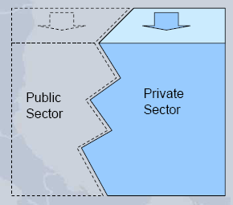
Public and private shared responsibility
Promotion of public-private partnerships
Insurance important risk management tool
Can be linked with improvement in risk management measures
Climate change creates risks for the insurers (higher loss probabilities)
but also opportunities (bringing new risks to the market) and an opportunity to heighten resilience
Notes:
But importantly the CCRIF and the activities which initiatives we have been involved in show the critical role that Public-Private partnerships can play in reducing risks and vulnerabilities faced by societies and the fact that more needs to be done to encourage this partnership towards improving resilience.
I hope my presentation has also highlighted the need for Continued support for reserve funds to support catastrophe insurance, as although just one tool within the wider disaster management toolkit, it is nevertheless a critical tool, especially in the event of a catastrophe.
But all of this is said within the recognition that it must sit within a wider comprehensive disaster management framework in which risk reduction is paramount.

Slide 35
The end
Thank you
www.ccrif.org
Notes:
Thank you.

