Slide 1
Technical Cooperation for Risk Reduction
South-South Cooperation: Replicating the Risk Reduction Management Centre, a Cuban model
UNDP - CRMI
Jacinda Fairholm
26 Nov. 2012

Slide 2
Objectives
Overall: to enhance capacity for local risk management and decision-making through south-south cooperation initiative
To build local capacity for risk assessment, analysis and management for the purpose of informed local decision making and improved coordination with national authorities
To strengthen use of risk management tools such as hazard and risk studies, vulnerability assessments, GIS mapping and data base management
To strengthen community-based early warning systems

Slide 3
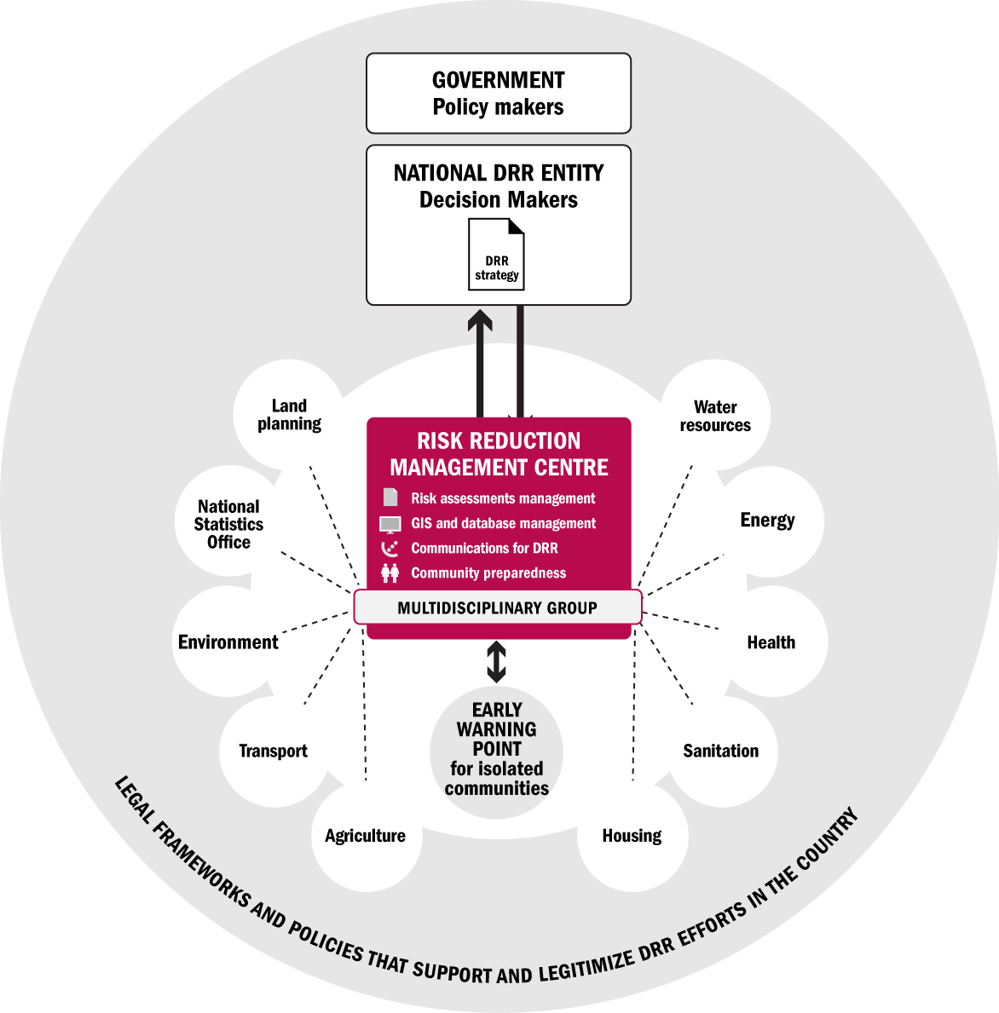
Constitutes an instrument of local governments designed to manage information about hazards, risks and vulnerabilities in a given territory
Is a small professional team that manages an information hub at the local level of governance
Is affiliated with and accountable to lowest level of political administration.

Slide 4
Function of a RRMC
Facilitate analysis and periodic assessment of local risks and factors that produce vulnerabilities with the participation of territorial institutions
Compile, process and prepare information derived from monitoring activities
Participate in the preparation of territorial disaster plans
Document and preserve historical memory
Contribute to the promotion of a disaster risk reduction culture in the population
Participate in response and recovery

Slide 5
What is transferable?
Articulation and coordination between actors
Priority on identification of vulnerabilities, hazards and risks
Use of appropriate technology
Support to systematic public education campaigns
Development and use of instruments positioned at territorial levels - as tools for local decision-making

Slide 6
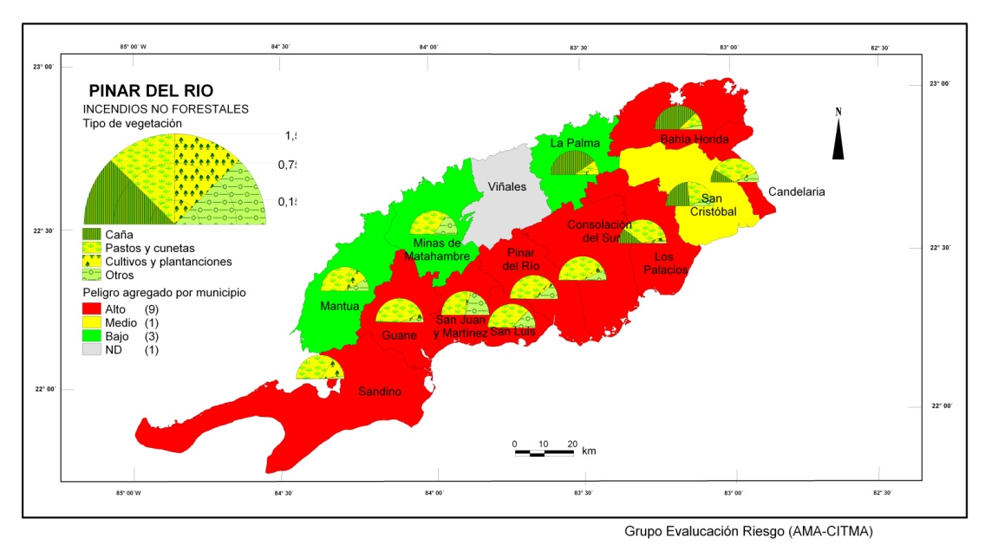
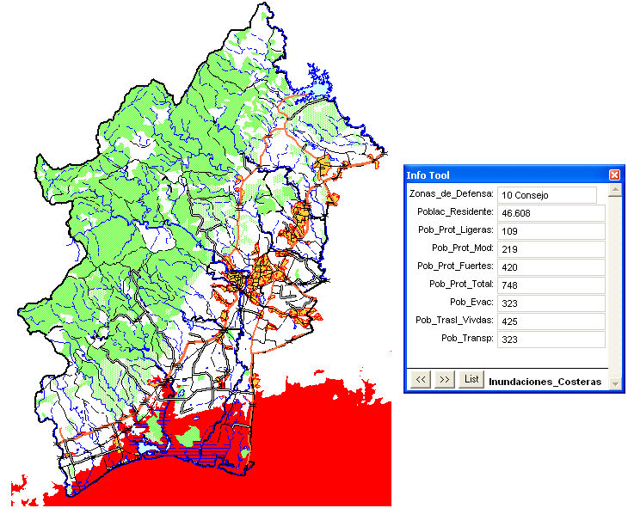
Seven Components
Early Warning Points
Multi-Disciplinary Group
Risk and Vulnerability Studies
Use of Data Bases
Use of GIS
Communication
Public Awareness and Community
Preparation

Slide 7
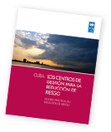
Process and Tools
Systematization
National Workshop
Guide and Fact Sheet
Selection of Pilot Countries
Study Tour
Identification of Roles and Responsibilities
Implementation Plan
Technical Training
Ongoing Technical Assistance
Documentation of Lessons Learned

Slide 8
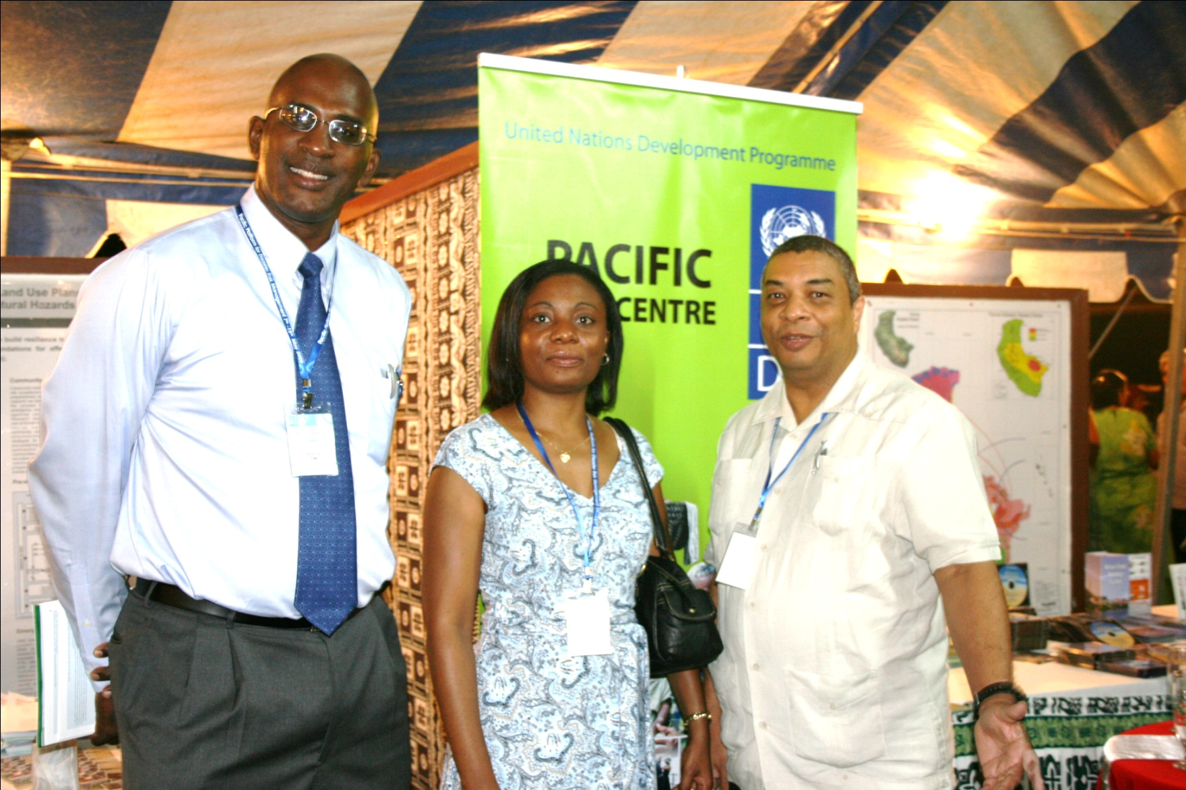
Role of Cuba
Development of model training site and training materials
Sensitization and Technical Training
Technical Assistance
Contribution to lessons learned in south-south cooperation

Slide 9
Role of UNDP
Accompany the process, providing communication, logistical and technical support as needed
Assist with resource mobilization and/or negotiating cost sharing agreements
Monitoring and support to pilot initiative – identification of lessons learned and coordination of knowledge sharing

Slide 10
UNDP – Knowledge Organization
Innovation
Documentation and dissemination of best practices
Accompaniment
Transfer of knowledge

Slide 11
Thank you!
Jacinda Fairholm
jacinda.fairholm@undp.org

